Slide 2
CAN YOU SPOT DIGITAL IMAGE MANIPULATION?
HINT: Look closely at lanes 2 and 3 — do the bands look suspiciously similar?

Slide 3
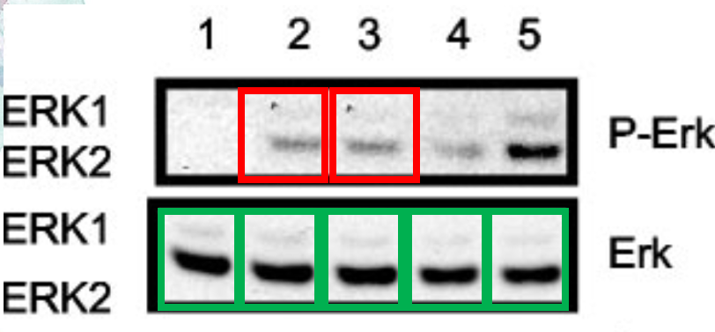
SOLUTION:
Red and green boxes highlight duplicated bands, suggesting manipulation…

Slide 4
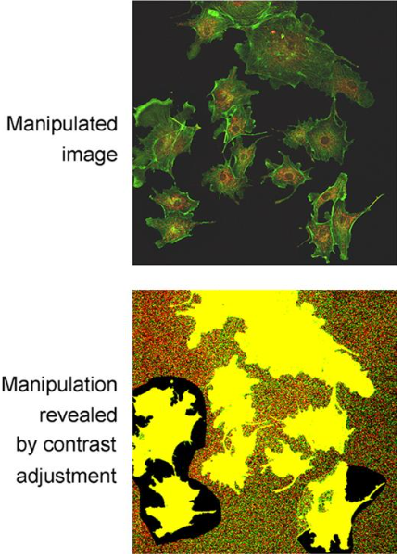
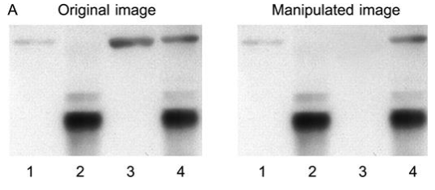
BACKGROUND
Image Manipulation and Research Misconduct:
Purposeful image manipulation to distort scientific experiment results is categorized as severe research misconduct.
Manipulations encompass various techniques, such as cropping, color adjustment, selective enhancement, and duplication.
Rossner and Yamada (2004)
Rossner and Yamada (2004)

Slide 5
BACKGROUND
Before we dive in — take a guess: What percentage of published scientific articles do you think contain inappropriate image duplications or manipulations?

Slide 6
BACKGROUND
Prevalence of Image Manipulation:
Recent studies have shed light on the higher prevalence of this phenomenon in the scientific community.
The extent of image manipulation in science is greater than previously perceived.
In one study ~4% of the surveyed papers contained some form of image duplication or manipulation (Bik et al, 2016).

Slide 7
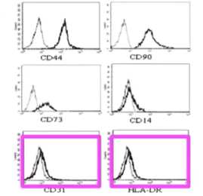
BACKGROUND
Image duplication : cloning objects into an image, to add features that were not previously present, taking the cloned object from the same or a different image.
Inappropriate image duplication:
Simple duplications;
Duplications with repositioning;
Duplications within the same figure.

Slide 8
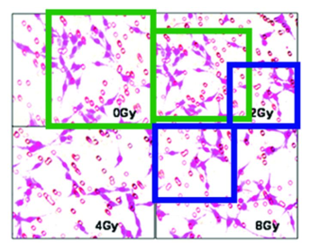
BACKGROUND
Image duplication : cloning objects into an image, to add features that were not previously present, taking the cloned object from the same or a different image.
Inappropriate image duplication:
Simple duplications;
Duplications with repositioning;
Duplications within the same figure.

Slide 9
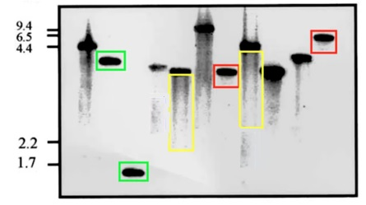
BACKGROUND
Image duplication : cloning objects into an image, to add features that were not previously present, taking the cloned object from the same or a different image.
Inappropriate image duplication:
Simple duplications;
Duplications with repositioning;
Duplications within the same figure.

Slide 10
CHALLENGE 1
CAN YOU SPOT IMAGE DUPLICATIONS?

Slide 11
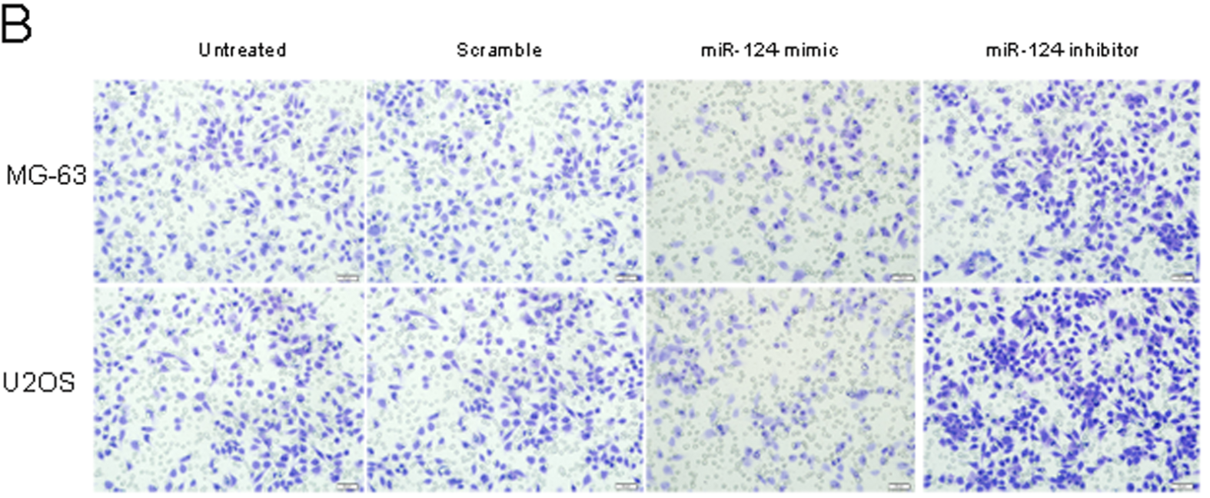
IMG. 1

Slide 12
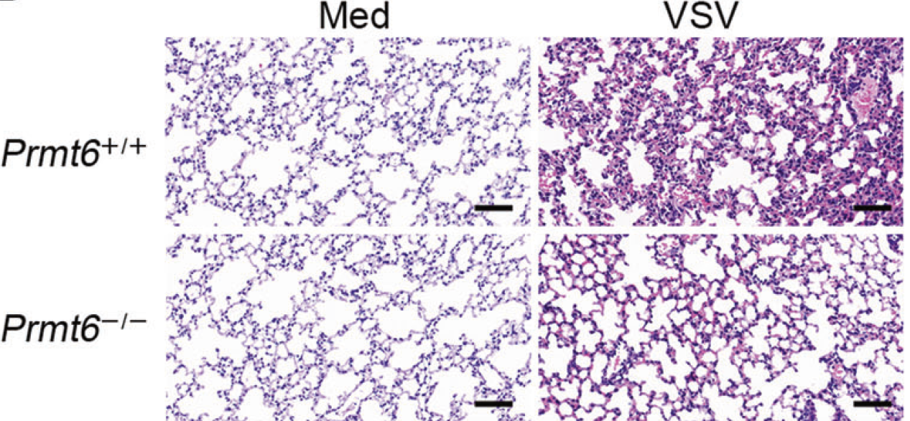
IMG. 2

Slide 13
IMG. 3

Slide 14
HOW TO DETECT IMAGE MANIPULATION
Visual inspection: looking for repeating patterns, irregularities, or inconsistencies in lighting and shadows
Software tools: programs like ImageJ, Forensically, FotoForensics, or Photoshop’s error level analysis
Use AI-based detectors: Employ machine learning tools trained to spot tampering

Slide 15
HOW TO DETECT IMAGE MANIPULATION
Image forensics tools
These tools help verify image authenticity by analyzing pixel-level data, metadata, and inconsistencies introduced during editing.
A common technique includes Error Level Analysis (ELA):
Detects differences in compression levels across an image.
Unedited areas usually have consistent error levels; manipulated parts often show different error patterns.
Useful for spotting copy-paste edits, cloned regions, or inserted objects.
Best used on JPEG images, since it relies on compression artifacts.
Notes:
s

Slide 16
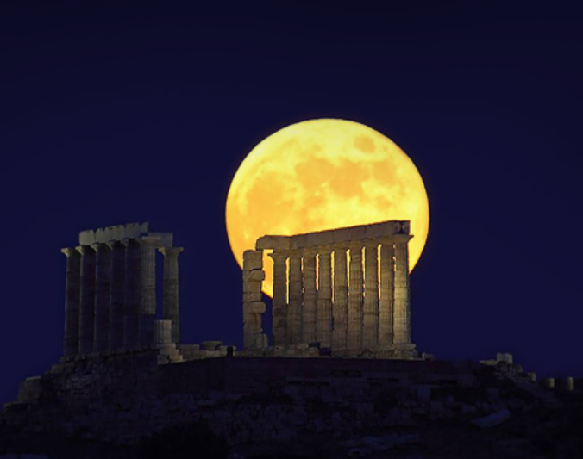
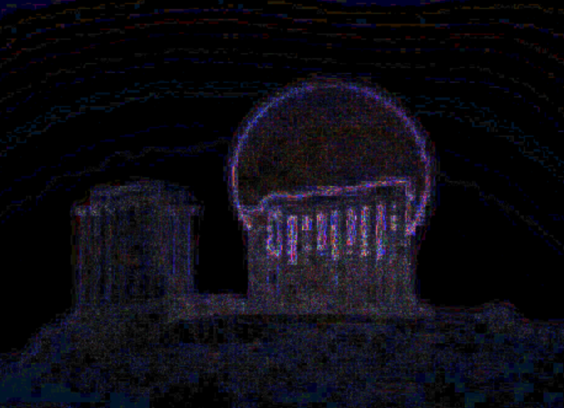
HOW TO DETECT IMAGE MANIPULATION
Image
ELA result
https://fotoforensics.com/

Slide 17
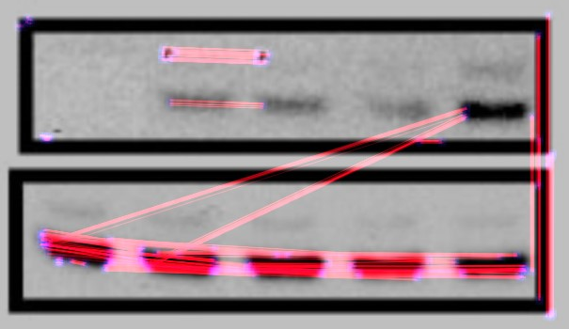
HOW TO DETECT IMAGE MANIPULATION
Clone detection:
The clone detector highlights similar regions within an image.
Regions that are similar are marked in blue and connected with a red line.
This can be a good indicator that a picture has been manipulated, however the tool is not yet very refined.
https://29a.ch/photo-forensics/#forensic-magnifier
Notes:
s

Slide 18
HOW TO DETECT IMAGE MANIPULATION
Limitations of traditional photo forensics tools:
Many tools (like ELA) only work on JPEG images—not ideal for other formats.
Requires trained eyes to interpret artifacts—subjective and prone to human error.
Can't detect AI-generated content, such as synthetic images or deepfakes.
Without access to the original file, it’s hard to confirm what’s been altered.
Time-consuming, especially for large datasets or subtle edits.

Slide 19
CHALLENGE 2
CAN YOU SPOT WHO IS REAL AND WHO WAS CREATED BY AI?

Slide 20
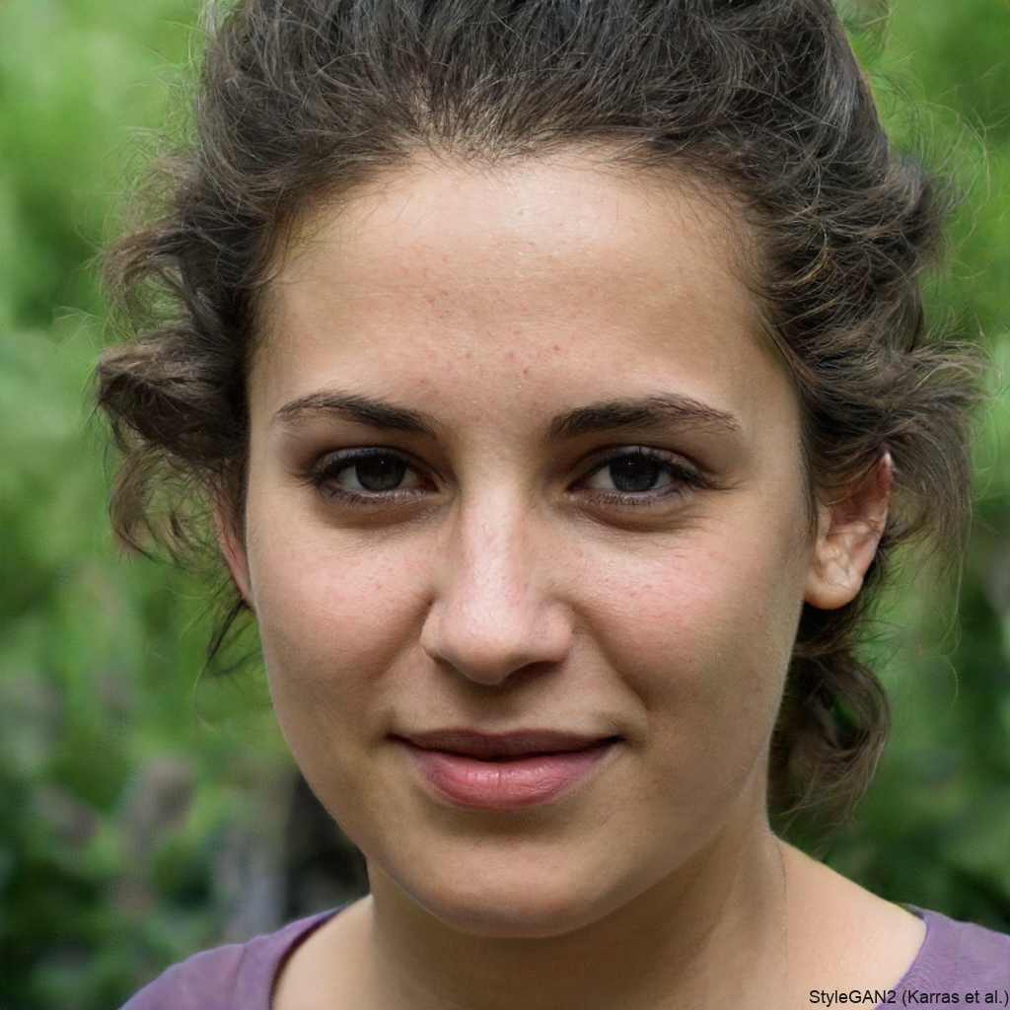
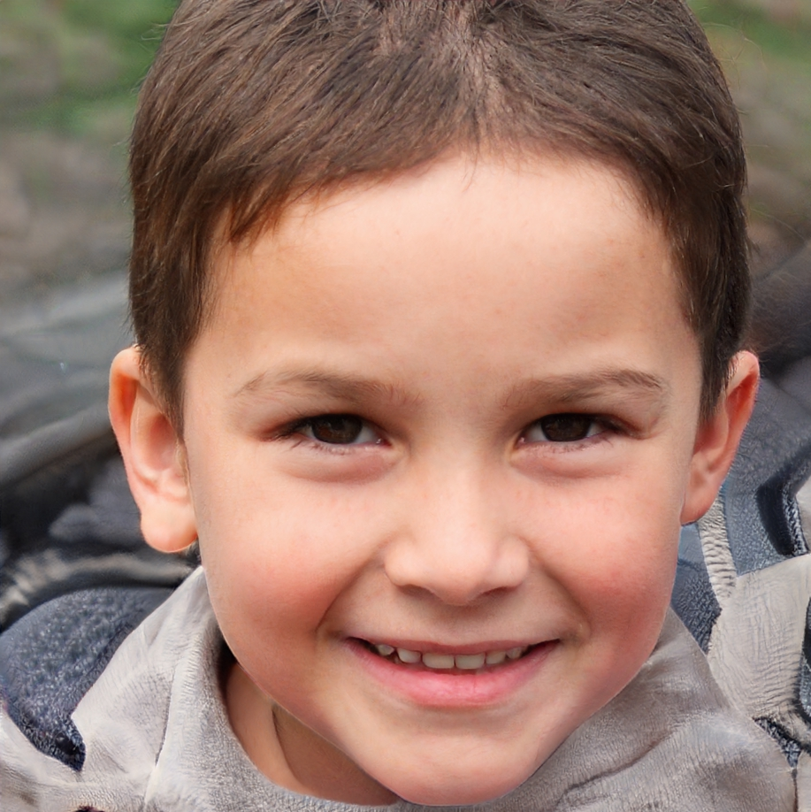
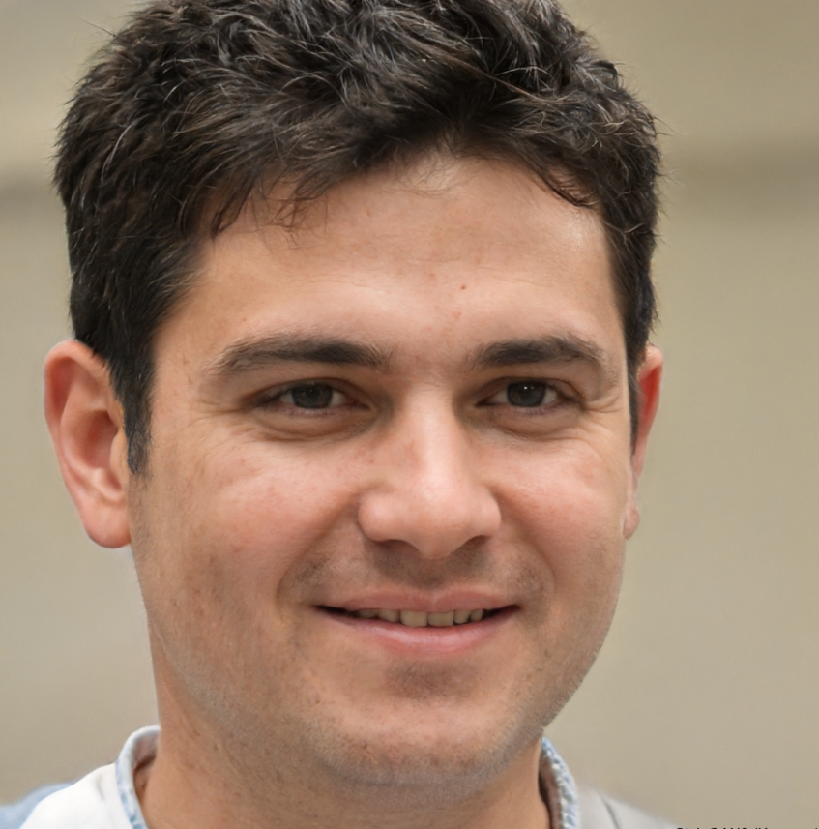
1
2
3
4
5
6

Slide 21
ANSWER
THEY ARE ALL AI-GENERATED.
Deepfake – type of deep learning artificial intelligence used to create convincing images and videos.
Deepfake image generator: https://thispersondoesnotexist.com/

Slide 22
AI-GENERATED IMAGES IN SCIENCE
Images that appear to show experimental results, but they may not be based on real data.
This undermines the reliability of scientific research and can deceive both reviewers and readers.
Difficult to detect, even for trained experts.

Slide 23
CHALLENGE 3
CAN YOU SPOT AI-GENERATED IMAGES?

Slide 24
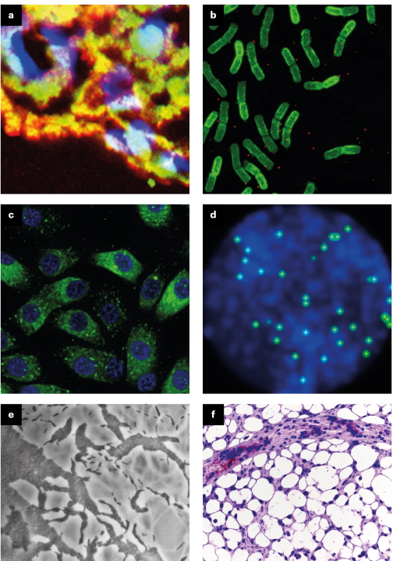
ANSWER:
Images b, c and f have been created with generative-AI technologies.
https://www.nature.com/articles/d41586-024-03542-8

Slide 25
HOW TO DETECT AI-GENERATED IMAGES
Deep Learning-Based Methods
These are sophisticated neural network architectures that learn to detect inconsistencies, or anomalies in images by analyzing visual features at multiple levels.
Advantages:
Enhanced ability to detect subtle manipulations.
Better generalization across diverse image types.
Challenges:
Require large datasets for training.
Performance can vary based on image quality and type.

Slide 26
DEEP LEARNING-BASED Methods
Convolutional Neural Networks (CNNs)
CNNs extract low- and mid-level features (edges, textures, lighting) that help detect tampering artifacts like inconsistent lighting, unnatural boundaries, or texture mismatches.
Yao, H., et al. (2020). Image forgery detection and localization via a reliability fusion map. Sensors, 20(22), 6668. https://doi.org/10.3390/s20226668

Slide 27
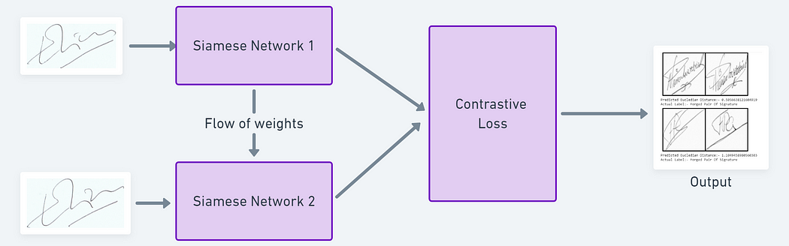
DEEP LEARNING-BASED Methods
Siamese Network
This is a deep learning architecture made of two (or more) identical subnetworks that share the same weights and parameters.
Each subnetwork processes a different input image (or patch).The outputs (feature vectors) from both networks are then compared using a distance function (like Euclidean or cosine distance).
Very effective in duplication detection.
https://medium.com/data-science/a-friendly-introduction-to-siamese-networks-85ab17522942

Slide 28
DEEP LEARNING-BASED Methods
Comparison of Deep Learning-Based Tools for Image Tampering and Deepfake Detection
Tool | Main Use Case | Deep Learning Method | Target Audience
Proofig | Scientific image duplication detection | CNN-based feature matching (likely Siamese-style) | Researchers, publishers, journal editors
Imagetwin | Scientific image manipulation and AI-generated content detection, image plagiarism detection | Deep learning models trained on scientific images | Researchers, publishers, institutions
Microsoft Video Authenticator | Real-time video/image manipulation detection | CNNs trained on deepfake datasets | General public, content platforms
Hive AI Detector | Commercial image moderation, deepfake detection | Hybrid CNNs/Transformers for visual inspection | Businesses, content platforms
Sensity AI | Enterprise-level deepfake and tampering detection | GAN fingerprinting, CNNs, custom deep models | Media monitoring, government, enterprise
Adobe CAI | Edit tracking and image authenticity verification | Visual edit tracking, metadata + deep learning | Creative professionals, publishers

Slide 29
SUMMARY
Image manipulation in science is real and prevalent, with studies showing ~4% of papers containing inappropriate duplications.
Traditional detection tools (like ELA or clone detectors) are limited by format, subjectivity, and scope.
AI-generated images and deepfakes are becoming harder to detect — even for trained experts.
Advanced deep learning methods enable accurate, automated detection of both tampered and synthetic images.

Slide 30
CONCLUSION
How to Prevent Image Manipulation?
Establish clear guidelines
Provide training and education
Use image detection tools
Enforce consequences and penalties for intentional manipulation
Promote a culture of integrity
Image taken from the Academy to Innovate HR (AIHR)

Slide 31
Q&A
Image from freepik.com
For any further inquiries or contact, please feel free to email at antonija.mijatovic@mefst.hr

Slide 33
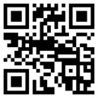
THANK YOU!
Follow us on social
X: @ChangerEU
Bluesky: @changereu.bsky.social
LinkedIn: www.linkedin.com/company/changer-eu-project/
CHANGER Website
Embassy of Good Science: embassy.science/wiki/Initiative:Df0d11b5-2efa-4b58-b94f-6845c6e83b11
Views and opinions expressed are however those of the author(s) only, and do not necessarily reflect those of the European Union. Neither the European Union nor the granting authority can be held responsible for them.

